Slide 1
Student Performance Evaluation
Data mining Course Project
Group Members
Indresh Singh (215280011)
Himanshu Gupta (215280024)
&
Raj Khandagale (215280002)

Slide 2
Understanding Data
Source : UCI directory , outsourced by Prof. Paulo Cortez
This data approach student achievement in secondary education of two Portuguese schools (Gabriel Pereira & Mousinho da Silveira)
Students are studying 2 subjects(Mathematics & Portuguese Language)
Data 1( Mathematics Students) : 396 rows and 33 Columns
1044 rows × 33 columns
Data2( Portuguese students): 650 Rows and 33 columns

Slide 3
Calculating the final score and Final Grade class
Final Score was being calculated as
Final score=g1+g2/2
Grade Class | Final Score
Poor | (0-9)
Fair | (10-14)
Good | (15-20)

Slide 4
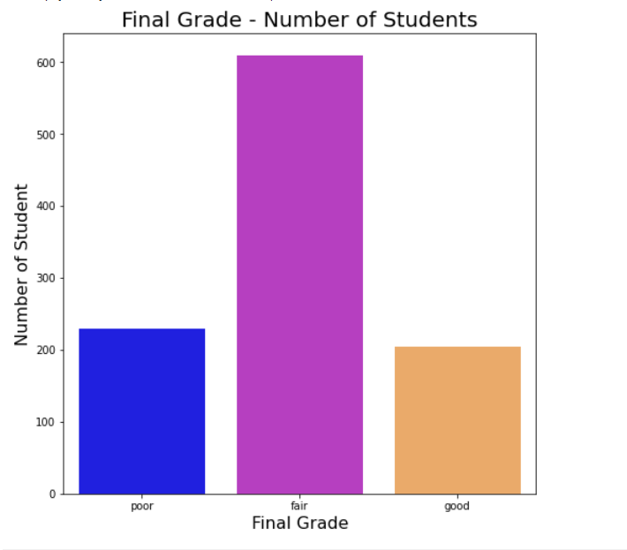
Exploratory Data Analysis

Slide 5
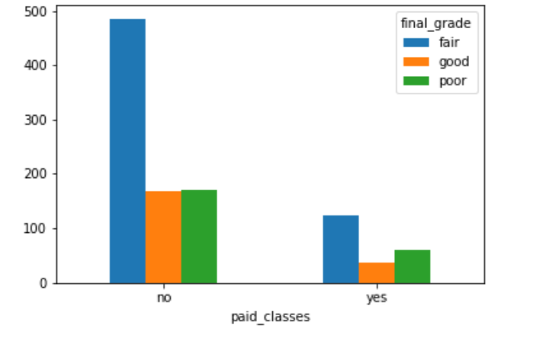
Relationship of Variables with Final Grade Class
Paid classes

Slide 6
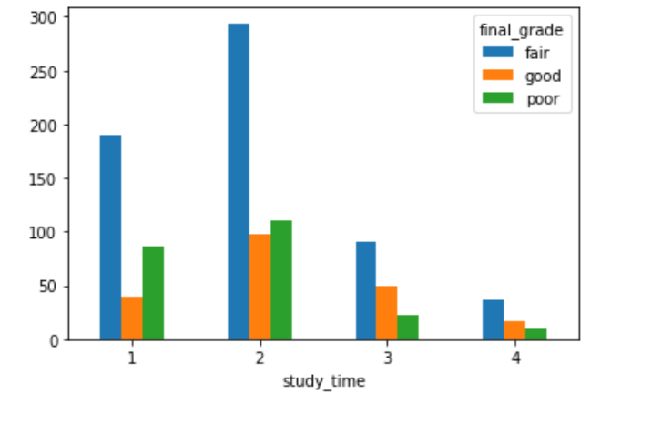
Scale | Hours/week
1 | < 2hours
2 | 2-5 hours
3 | 5-10 hours
4 | 10 hours
Study time

Slide 7
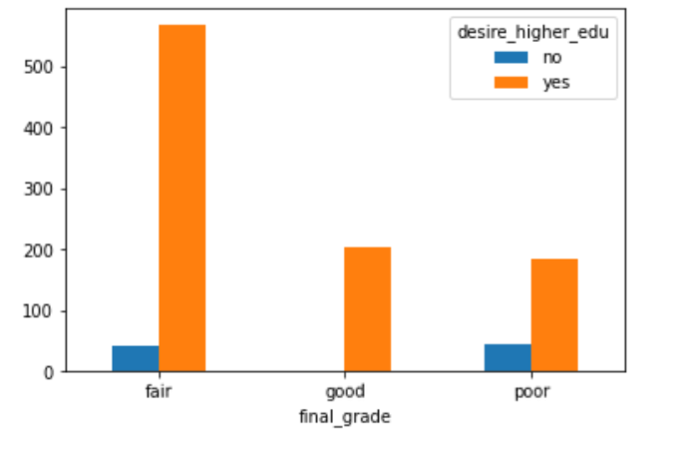
Desire to higher education

Slide 8
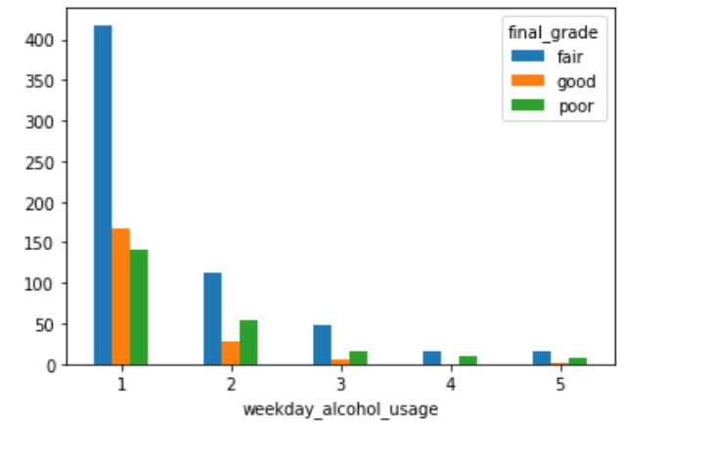
Weekday Alcohol consumption

Slide 9
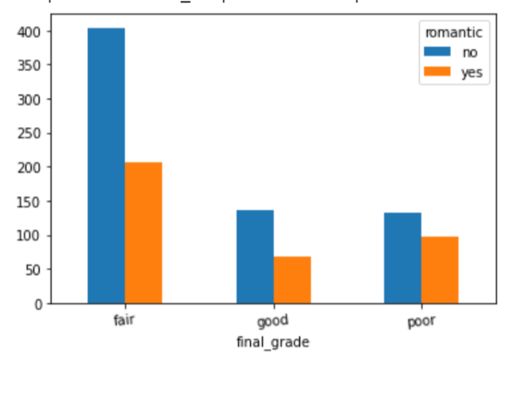
Relationship

Slide 10
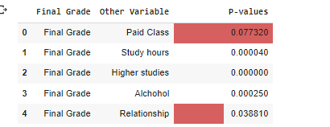
Chi Square test of association
At 5% Level of significance Final Grade does not depend on whether student has joined
A paid coaching class or not
And depends on No of study hours , Desire for higher studies , Alcohol consumption & Relationship

Slide 11
Preparing Data for Classification
We removed Final Score because we have coded it as Poor , Fair and Good and Stored as Final Grade
We encoded categorical variables by label encoding
e.g. binary yes/no variable by 1-0 encoding
So 33 features got converted into 58 encoded features

Slide 12
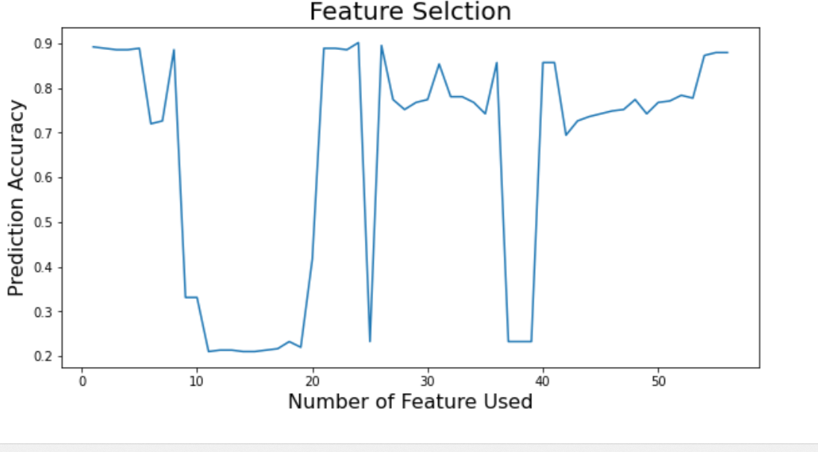
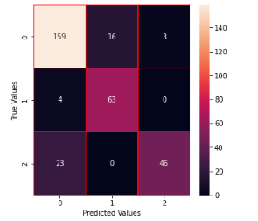
Multinomial Logistic Regression Model
24 Features
MLRM model
Accuracy was found to be 0.8535031847133758 for MLRM

Slide 13
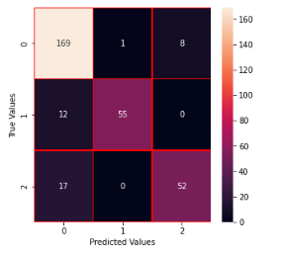
Random forest classifier
Accuracy of random forest model is
0.8853503184713376

Slide 14
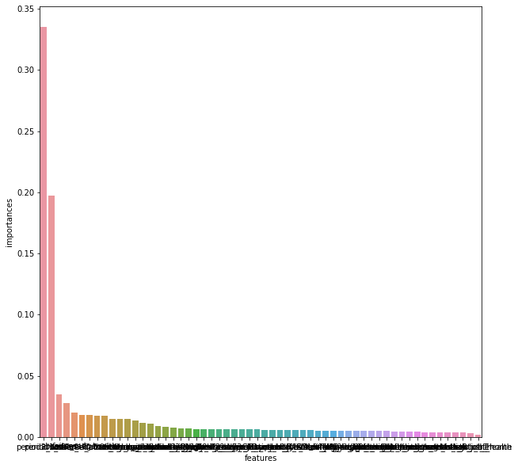
Feature Importance

Slide 15
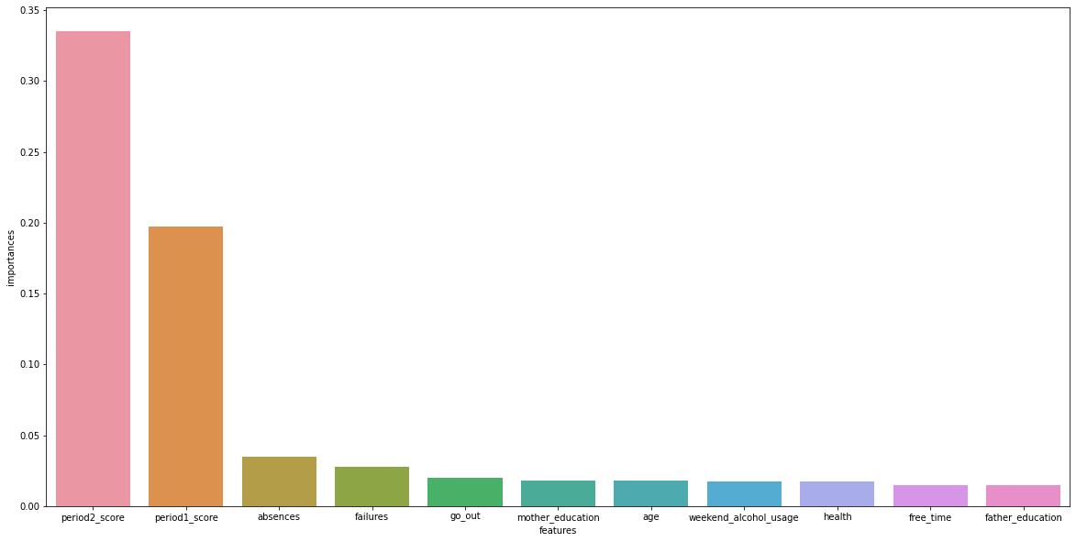
Top 11 feature Importance

Slide 16
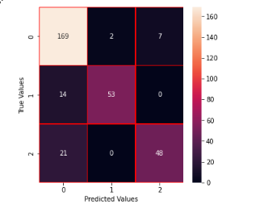
Support Vector classifier
Accuracy of Support Vector Classifier was
Found to be 0.8598726114649682

Slide 17
Results
Random forest model is having highest model accuracy which is 0.8853503184713376
Most Influential features for Student’s performance based on Random forest model were listed as follows :
Period2_score( Endsem )
Period1_score( Midsem )
failures
absences
Going out
health
Mother’s education
Age
Weekend alcohol usage
Father’s education
Free time

Slide 18
Student with following qualities will perform better in exams
No alcohol consumption ❌ 🍺🥃
Study for more than 5 hours Per week 📚📔📕📖
He has desire for higher education 🏫🏫🏫
He has no romantic relationship 💘❌
Scores better in End-Semester Exam
With less past backlogs
He has good health condition 💪
Less absentees in class
He’s mother & father has is well educated

